Slide 1
REsponse PADA LATAVEL 5.6

Slide 2
PENGERTIAN REsponse PADA LARAVEL 5.6

Slide 3
METHOD | FUNGSI

Slide 4
METHOD | FUNGSI

Slide 5
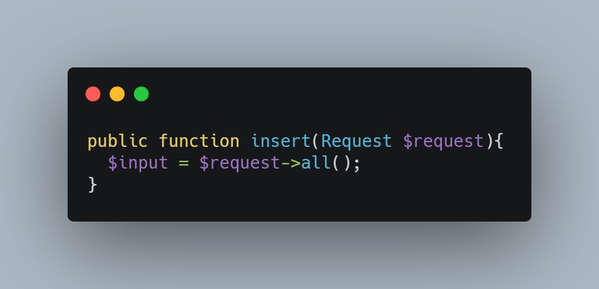
Pengaksesan response

Slide 6
terimakasih
‘When there is no desire, all things are at peace. – Laozi’

